Slide 1







GIT pipeline triggers model evaluation and registers best performing Model(s) to snapshot model registry
Data
Preparation
Exploratory
Data Analysis
Feature
Engineering
Model
Training
Model
Validation
ML
Deployment
Continous
Monitoring

Slide 2








Data Engineer
Data Scientist
ML Engineer
Business Stackholder
Data Owner
Responsible for building data pipeline, register dataset and persist data for machine learning
Training and online inferencing
Responsible for understanding the business problem, exploring available data to understand if machine learning is applicable, and then training, tuning and evaluating a model to be deployed.
Responsible for deploying
machine learning models to
production with appropriate
governance, monitoring and
software development best
practices such as continuous
integration and continuous
deployment (CI/CD).
Responsible for using the
model to make decisions for
the business or product, and
responsible for the business
value that the model is
expected to generate
Responsible for ensuring
that data governance,
data security and other
compliance measures are
adhered to across the
model development and
deployment process. Not involved in day-to-day ops.
Data Engineer
Lab Platform Engineer
Data Scientist
Model Owner
MRMC
ML Engineer
Business Stackholder
Data Owner
Within UBS; It is typically a data engineer from the Model IT team attached with the data scientist business division
Within UBS, Divisional Lab environment IT engineer, such as RiskLab IT, is responsible to ensure day-to-day data governance in Lab environment, and platform support in MLOps
Within UBS, it is typically a ML data scientist from the business division or an IT ML data scientist who perform ML model training and evaluation.
Within UBS, a model owner could also be the data scientist that perform the ML model development; however, the model owner’s role is to perform additional model evaluation and prepare for MRM validation submission
Within UBS, MRM team is responsible for validating all model submission, only validated model could be prepared for staging and production deployment.
Within UBS, it is typically an IT engineer from the Model IT team attached with the data scientist business division, ML Engineer also have the additional responsibility to ensure day-to-day data governance is maintained in IT
Within UBS, Business stockholders is normally represented by product manager from each chapter, who will organize regular business sign-off and stockholder management
Within UBS, DGP data owner in conjunction with IT division CTO has collective responsibility to ensure data governance, access security and compliance is fully met.

Slide 3
Data Engineer
Lab Platform Engineer
Data Scientist
Model Owner
Within UBS; It is typically a data engineer from the Model IT team attached with the data scientist business division
Within UBS, Divisional Lab environment IT engineer, such as RiskLab IT, is responsible to ensure day-to-day data governance in Lab environment, and platform support in MLOps
Within UBS, it is typically a ML data scientist from the business division or an IT ML data scientist who perform ML model training and evaluation.
Within UBS, a model owner could also be the data scientist that perform the ML model development; however, the model owner’s role is to perform additional model evaluation and prepare for MRM validation submission
MRMC
ML Engineer
Business Stackholder
Data Owner
Within UBS, MRM team is responsible for validating all model submission, only validated model could be prepared for staging and production deployment.
Within UBS, it is typically an IT engineer from the Model IT team attached with the data scientist business division, ML Engineer also have the additional responsibility to ensure day-to-day data governance is maintained in IT
Within UBS, Business stockholders is normally represented by product manager from each chapter, who will organize regular business sign-off and stockholder management
Within UBS, DGP data owner in conjunction with IT division CTO has collective responsibility to ensure data governance, access security and compliance is fully met.

Slide 4

Data Owner
Lab Platform Engineer
ML Engineer
Data Engineer
Data Engineer
Data Scientist
Data Scientist
Model Owner
Model Owner
MRMC
MRMC
Business stackholder
Data
Preparation
Exploratory
Data Analysis
Feature
Engineering
Model
Training
Model
Validation
ML
Deployment
A/B Testing
(optional)
Continous
Monitoring

Slide 5















Experimentation
Tracking
Tool
Model
Reproducibility
Tool
Model
Pipeline
Model
Registry
Model
Deployment
Tool
Monitoring and
Drift detection
Tool
Feature
Store

Slide 6


Development
Workspace
Production data access
Sandbox data storage
Feature
Store
ML Training / Evaluation
Inference Pipeline
Foundation Models
& library dependency
Experimentation
Tracking
Tool
Model
Registry
Model
Deployment
Tool
Monitoring and
Drift detection
Tool
ML Bill of Materials
& Lifecycle Observability
Compute
Orchestration
Tool
Model
Reproducibility
Tool

Slide 7
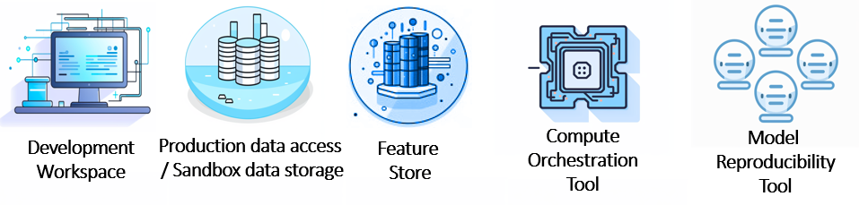
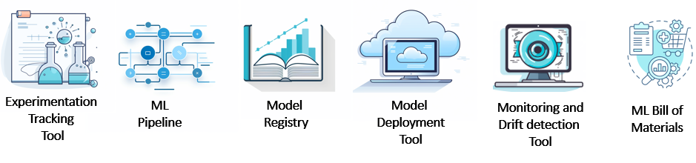

Slide 8
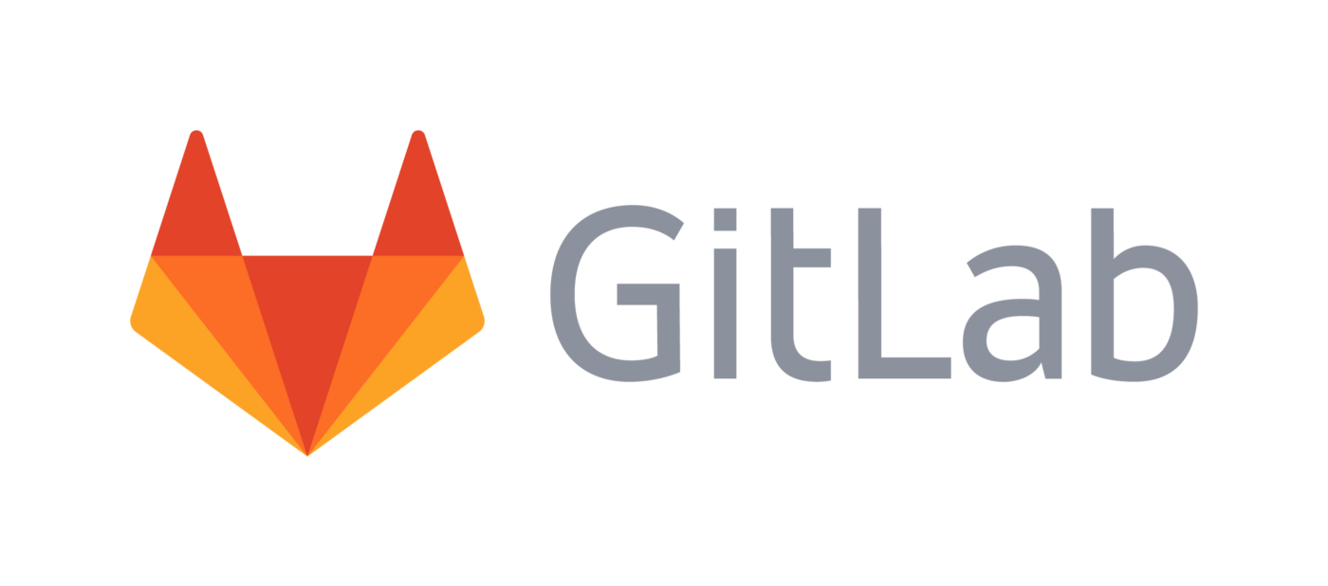





/model
train.py
infernece.py
evaluate.py
/data
featurization.py
/test
unit.py
/model
train.py
deploy.py
inference.py
monitoting.py
/data
featurization.py
/test
unit.py
integration.py
MLFlow Project
review
MLFlow Project
UBS Production Data Mesh
RiskLab Sandbox
MEGDP
Cumulus
IB Datahub
Feature Store
Metrics Log

Slide 9
/deploy_pipeline
/online_service
/batch_service
/stream_service
/monitoring
/model
train.py
deploy.py
inference.py
monitoting.py
/data
featurization.py
/test
unit.py
integration.py
IT Project
dev
MLFlow Project
/deploy_pipeline
/online_service
/batch_service
/stream_service
/monitoring
IT Project
main
/online_service
/rest-api
/react-app
/batch_service
/stream_service
ML App
Prototype
main

Slide 10



MLFlow Project
Exploration
Data + Features
Model Dev
Model Training Pipeline
Exploratory
Data Analysis
Data
Preparation
Feature
Engineering
Model Code
Development
Setting up
Experiment
Experiment
Runs
Notes:
10

Slide 11


ML App Prototype
ML App Demo
Fast ML App
Development
Prototype
Inference

Slide 12
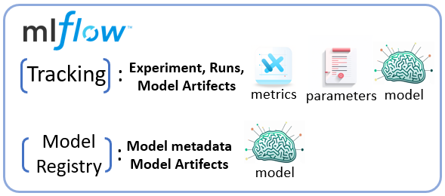
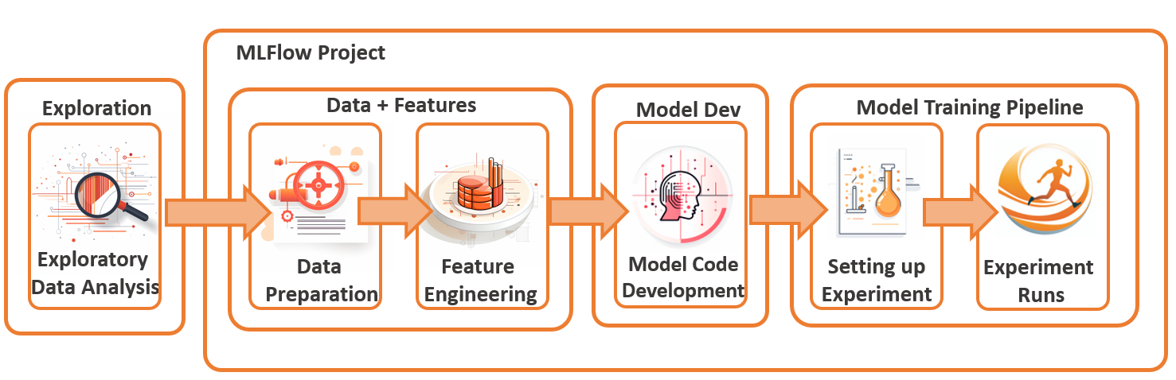
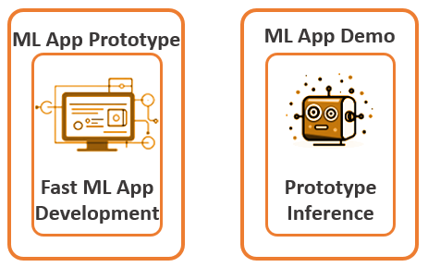
Model Development Lab Enviorment:
RiskLab, Domino, Dataiku, Adana,
Databricks, Azure ML

Slide 13
Re-execute ML Model pipeline with existing /new parameters, models
Exploration
Data + Features
Model Training Pipeline
Exploratory
Data Analysis
Data
Preparation
Feature
Engineering
Setting up
Experiment
Experiment
Runs

Slide 14
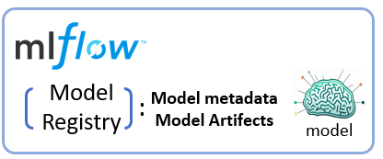

Code Development
Ancillary Code
Development
GIT Release Process (CI)
Integration Training (CI)
Unit
Testing
Build
Artifact
Deployment
Testing
Inference
Testing
Monitoring
Testing
Notes:
14

Slide 15




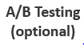
A/B Testing
(optional)
Real-Time, Batch, Streaming Infernece
Monitoring
Inference
Service
Logging
metrics
Read metrics
Detect drift
Trigger
Event
Notes:
15

Slide 16
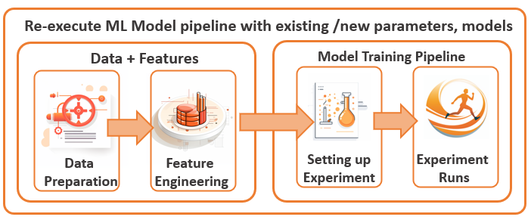

Model Review Lab Enviorment:
RiskLab, Domino, Dataiku,
Databricks, Azure ML Service
Validate Metrics
Review Tests
Review MLFlow
Run metrics
Unit Testing

Slide 17
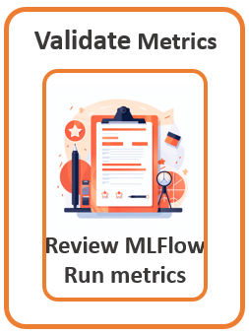
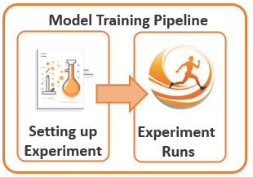
Model Review Lab Enviorment
Model Development Lab Enviorment

Slide 18
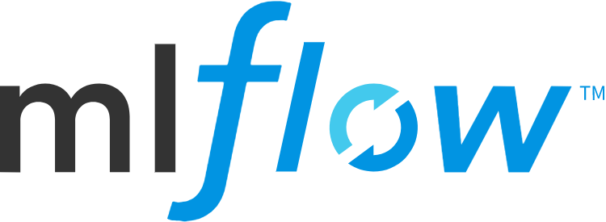



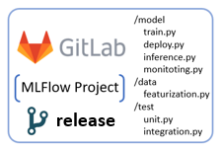
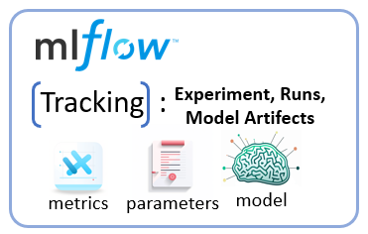
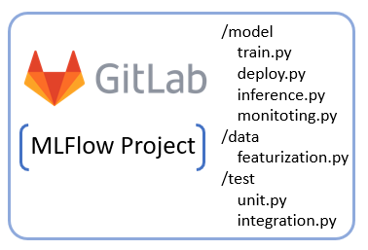
Tracking :
Experiment, Runs,
Model Artifects
metrics
parameters
model
Model Development Lab Enviorment:
Model
Registry
Model metadata
Model Artifects
:
model
main
review
release

Slide 19
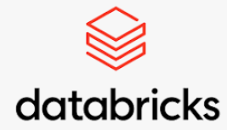
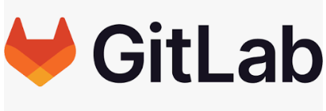



Experiment Tracking
Experiment Tracking
Experiment Tracking
Experiment Tracking
Experiment Tracking
Model
Registry
Model
Registry

Slide 20
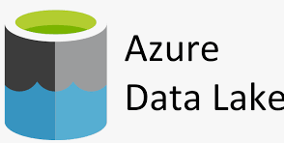

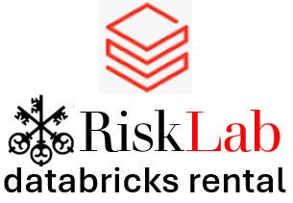
Model Artifact
Storage
Experiment Tracking
Experiment Tracking
Experiment Tracking
Experiment Tracking
Model
Registry
Experiment Tracking

Slide 21
Experiment Tracking
Experiment Tracking
ML Model API +
ML App Hosting
ML Model Deployment
Serverless Model API
ML-Training, RiskLab Workspace, Databricks Jobs
ML-Training, CT

Slide 22
Experiment Tracking
Experiment Tracking
Experiment Tracking
Experiment Tracking
Experiment Tracking
Model
Registry
Experiment Tracking

Slide 23




Snapchat brunch
MDLC Lifecycle Tracking
MLBOM Lineage
Governance
AGENT
MDLC Lifecycle Tracking
MLBOM Lineage
Governance
MLBOM Lineage
Governance
1
2
3
4
5
6
7
8
9
10
11
12
13
14

Slide 24
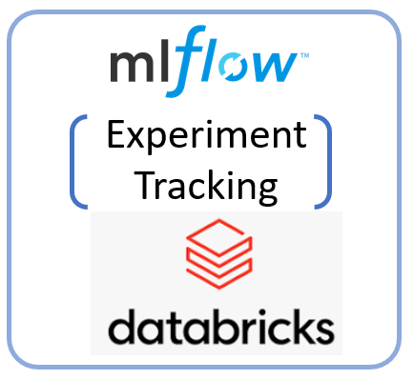
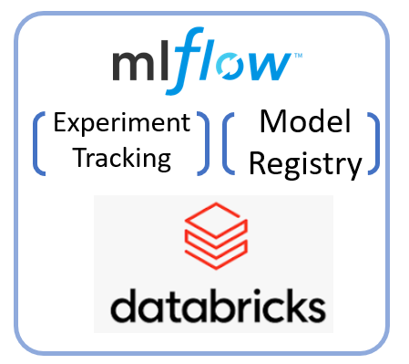



ML Lab Platforms
Having only dev data access
IT maintained ML Lab Platforms
Having prod data access
Run expertiment against prod data
And auto select and register model
Evaluate Model, Metrics, Data
Experiments on dev data
For purpose of generating
Training pipeline
Check-in
training pipeline
+ ML App
Evaluate Code
MRMC
Data Scientists

Slide 25



MDLC Automation enablement tooling
MDLC demands specialized tools, libraries, and storage to enable its automation. Often, ML Platform
RiskLab
databricks rental

Slide 26

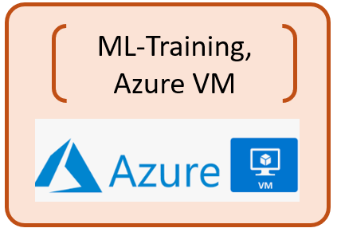
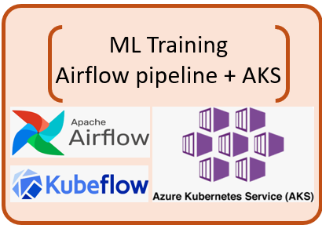

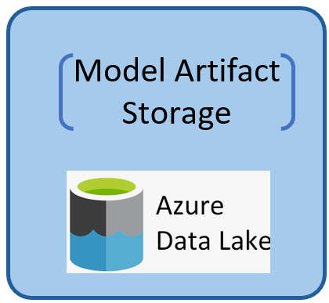
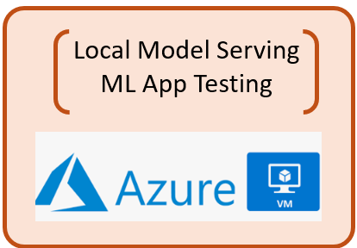
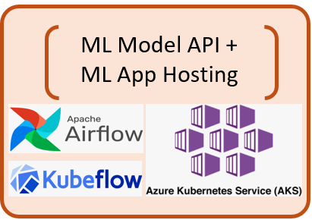
4
ML-Engineer
Data scientists develop ML training pipelines and experiment scoring/selection modules in private UBS VMs or Azure VMs accessing development datasets.
Data scientists either manually run the training pipeline using a variety of ML frameworks, with model artifacts generated and persisted into the data scientist-owned Azure storage, for example, ABFS.
Data scientists can optionally pull those artifacts from storage and host the ML inference API locally for endpoint testing and ML app testing.
Data scientists check in ML training pipelines and experiment scoring/selection modules to GitLab.
IT ML engineers check out the training and selection pipeline and schedule the model training in an IT-maintained AKS cluster having production data access. Often, an open-source pipeline framework is used, for example, Apache Airflow or Kubeflow pipeline.
The training and experiment scoring/selection pipeline will automatically select the best-performing model and store it in the IT-owned cloud storage.
ML engineers can deploy the ML API on AKS cluster real-time serving or cluster-based batch inferencing.
ML engineers can follow the SDLC process to deploy ML applications on IT AKS clusters consuming the ML API endpoints. For batch inferencing, often the workload is scheduled by Apache Airflow or Kubeflow. There are commercial solutions such as Seldon, but they have not been adopted within UBS.
1
5
Data Scientists
Dev Local VM
IT AKS Environment
2
6
Dev Data
Prod Data
Data Scientist Owned Storage
IT Owned Storage
7
Data Scientists
3
8
ML-Engineer
Dev Local VM
IT AKS Environment
Dev Data
Prod Data

Slide 27
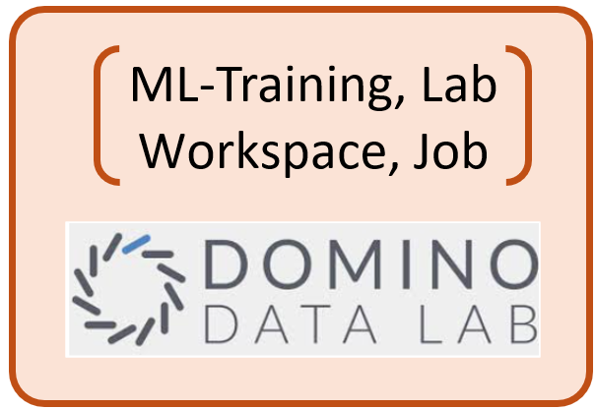
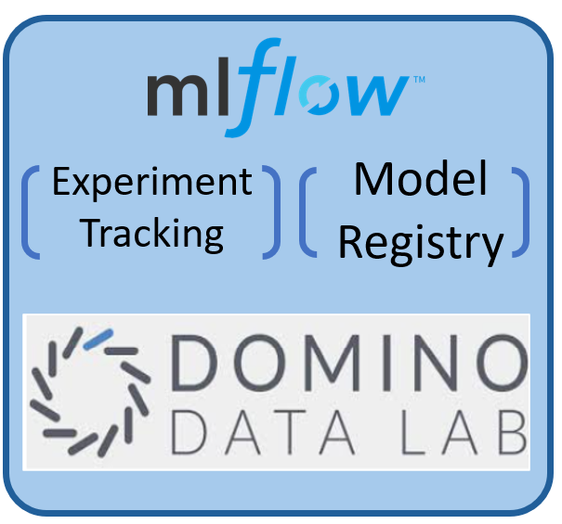
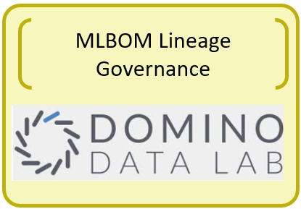
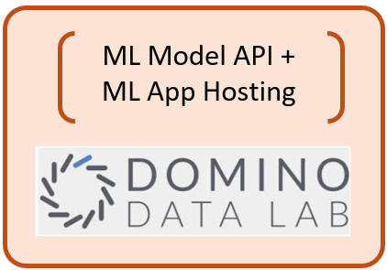
MDLC in Practice: Case 2: Data Scientist Centric Training and Inference on ML Platform
Data Scientists develops ML training pipeline (Kedro) in Production model development environment with direct production data access
Data Scientists checks in ML training pipeline to GitLab.
Data Scientists schedule Domino Jobs, which checks out training pipeline from GitLab and starts executing the training pipeline within Domino AKS.
Training pipeline generates one or more experiments and each experiments has model artifacts created and stored within MLFlow experiment tracking.
Data Scientists can optionally register an experiment run’s artifacts to MLFlow model registry for Lab model publishing
Data scientists publishes ML model as an Domino Model API for batch or real time inferencing.
Data scientists can also develop ML application (for example, Streamlit, Dash, ReactJS) and publish the ML App to Domino App. RiskLab can support EUA ML applications inference with production data.
Domino can setup your model to be countinous monitored, and define scheduled check to alert on drift and progtrammtically retrain model.
Domino Data Lab tracks ML Bill of Materials information for end to end Model governance (Preview)
2
3
1
8
Data Scientists
Prod RiskLab ML
Training Platforms
Prod Data
4
5
Data Scientists
9
Prod RiskLab MLFlow
6
Data Scientists
7
Prod Data
Prod RiskLab ML Platforms

Slide 28
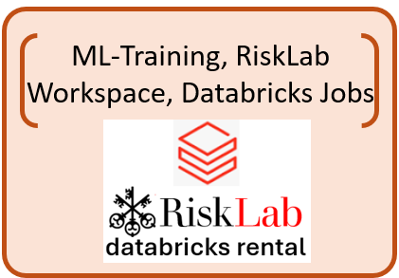
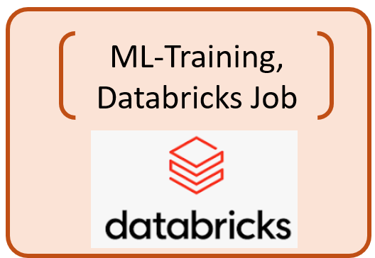
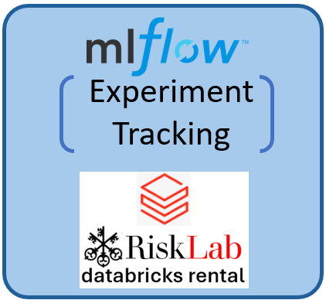
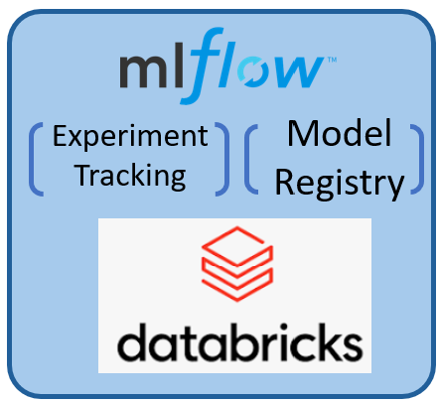
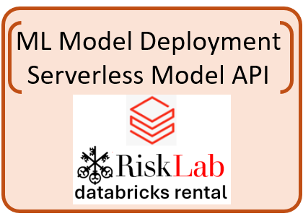
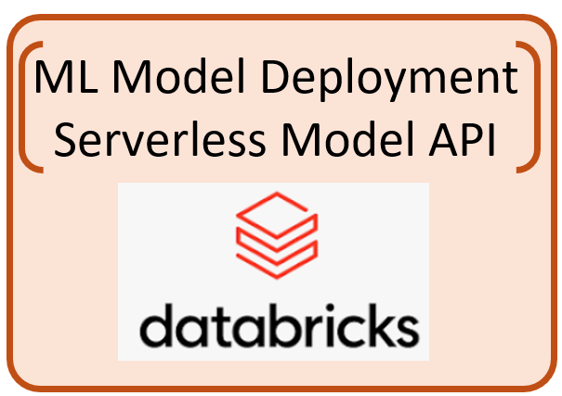
Data Scientists develops ML training pipeline and experiment scoring / selection module in RiskLab Databricks rental workspace (MLFlow Pipeline / Kedro) in production tier model development environment with direct product data access.
Data Scientists either manually runs the pipeline or schedule databricks ML training jobs. Training pipeline generates one or more experiments and each experiments has model artifacts created and stored within Risklab Databricks Rental MLFlow experiment tracking sever
Data scientists can optionally manually publish ML model onto Databricks serverless Model serving API (UBS curated End of Q2, 2024)
Data Scientist can optionally develop and hosting ML Application in RiskLab Databricks Rental Lakehouse App (Private Preview, no UBS curation date) , or hosting in an external solution.
Data Scientists checks in ML training pipeline and experiment scoring / selection module to GitLab
IT ML Engineer checks out training and selection pipeline and schedule the model training in an IT environment having production data access.
The training and experiment scoring, and selection pipeline will auto select the best performing model and registry it with Central / Divisional MLFlow model registry.
ML Engineer can deploy the ML API for Serverless real time serving or Cluster based batch inferencing.
ML Engineer can follow SDLC process to deploy ML application within Lakehouse App or from an external IT maintained Application hosting.
ML-Engineer
5
1
6
Data Scientists
Prod RiskLab Databricks
Rental ML Training Platforms
IT ML Training
Platforms
2
Prod Data RIskLab
Prod Data
7
Prod RiskLab Databricks MLFlow Experiment Tracking
Central/Divisional IT MLFlow
Experiment Tacking / Model Registry
3
8
Data Scientists
ML-Engineer
4
9
Prod Data RIskLab
Prod RiskLab Databricks
Rental ML Platforms
IT ML Inference
Platforms
Prod Data

Slide 29
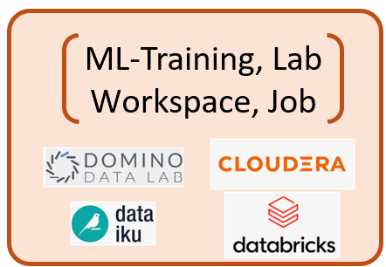
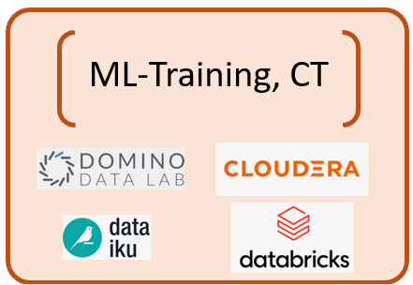

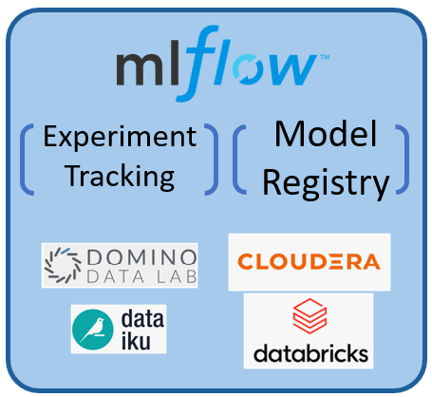
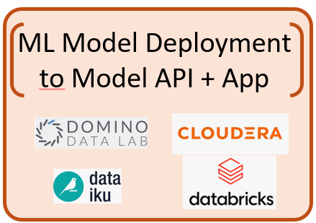
4
Snapchat Branch
8
Release Branch
Data Scientists
1
5
9
13
Prod Lab ML Platforms
IT Snapshot CT ML Platforms
IT PROD CT ML Platforms
Dev/Prod Data
Prod Data
Prod Data
Model Scan
Model Scan
Model Scan
2
6
10
Data Scientists
Data Scientist Lab MLFlow
Experiment Tacking
Central/Divisional Snapshot MLFlow
Experiment Tacking / Model Registry
Central/Divisional PROD MLFlow
Experiment Tacking / Model Registry
11
ML Engineer
ML-Engineer
12
Data Scientists
3
7
Data Scientist Lab ML Platforms
IT TEST / MRMC Validation
ML Platforms
MRMC
IT PROD ML Platforms
Dev/Prod Data
UAT/Prod Data
Prod Data

Slide 30
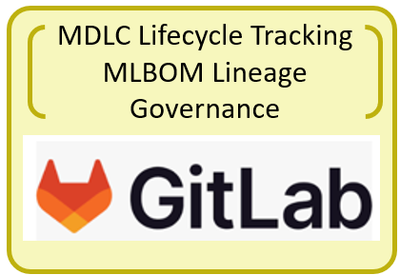
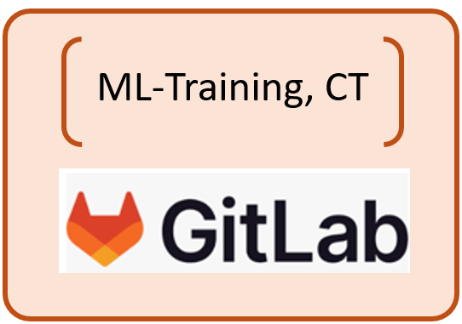
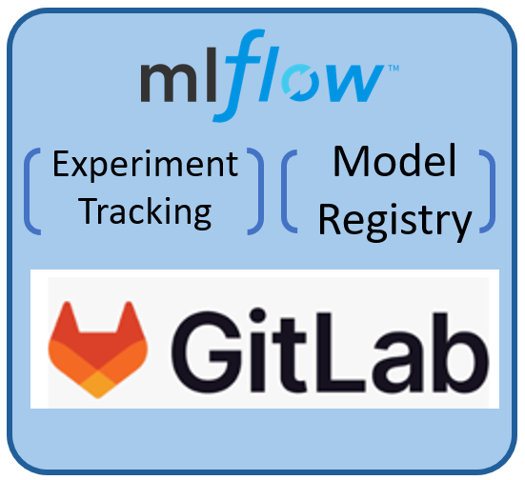
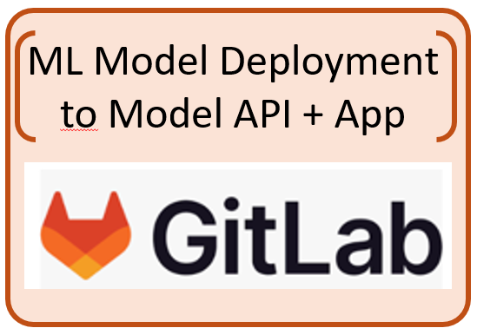
Option 1: Single GIitLab ML platform provides end to end MDLC Lifecycle tracking and MLBOM tracking
Since GitLab is the bank’s SDLC implementation platforms, and GitLab is working toward a complete end to end ML Solution. We would ideally want GitLab to provide the following functionalities in order to capture the complete MLBOM
GitLab pipeline and AKS cluster could able support Continuous Trainings to machine learning models. i.e. not limiting GitLab for artifact building job, but for ML model training jobs.
GitLab Model registry would provide experiment tracking
GitLab Model registry could allow Central / Divisional model registry management and access control.
GitLab AKS cluster could provide ML Model API hosting for real time and batch inferencing.
GitLab AKS cluster could provide ML App hosting.
A GitLab central panel could see the complete
However, GitLab only started MLOps development since 2022, and their product has not matured yet, We see the described landscape might be potentially fulfilled in 2026/2027. The challenges are:
GitLab Model registry are only limited to Project scope. Does not provide central model registry management and access control.
GitLab needs to provide product roadmap in support ML pipeline including advanced multi-cluster ML trainings
GitLab needs to provide product roadmap in ML model API hosting similar to HuggingFace space, and the SLA needs to be production grade.
As 3, the same would also apply to ML Application hosting.
Snapchat Branch
Release Branch
Data Scientists
develops model
In diverse Model
Development
environment
IT Snapshot CT ML Platforms
IT PROD CT ML Platforms
Prod Data
Prod Data
Central/Divisional Snapshot MLFlow
Experiment Tacking / Model Registry
Central/Divisional PROD MLFlow
Experiment Tacking / Model Registry
ML Engineer
ML-Engineer
MRMC
IT TEST / MRMC
Validation ML Platforms
IT PROD ML Platforms
UAT/Prod Data
Prod Data

Slide 31

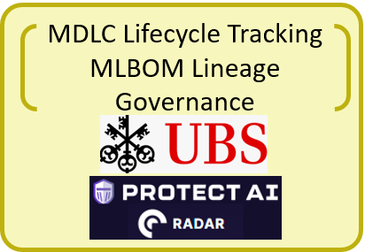
Option 2: Diverse choice of ML Platform for ML CT, CD and CM. Deploy MLBOM Tracking agent to garther MLBOM including the ML lifecycle information to build UBS’s bankwide Model Lifecycle Tracking and MLBOM Lineage Governance Tool
Protect AI is the industry leading MLSecOps company, and its RADAR product offers complete observability of “tamper-proof” ML Bill of Materials (MLBOM) for comprehensive list of components and dependencies of your ML model. The information is extracted by deploying RADAR agent through the lifecycle of ML model at different ML platform for CT and CM, and GitLab for CI and CD.
A UBS in-house built MDLC lifecycle Tracking application can be built on top of the PROTECT AI gathered MLBOMs. As ML lifecycle stages is a key MLBOM for Protect RADAR to track.
GCTO Big Data team, RiskLab and GCRG Model methodology has done a PoC on UBS MDLC lifecycle application during the 2023 Hackathon to support the ML model lifecycle tracking from diverse range of ML Training and Inference platform. This PoC could be leverage PROTECT AI RADAT framework to also offer additional observability of ML Model Bill of Materials information.
Advantage of the Option 2:
Quick Time to Market for end of end ML CICDCTCM solution.
Allowing Diverse range of ML Platform to be supported.
UBS custom in house lifecycle application with MLBOM tracking.
Snapchat Branch
Release Branch
Data Scientists
develops model
In diverse Model
Development
environment
IT Snapshot CT ML Platforms
IT PROD CT ML Platforms
Prod Data
Prod Data
Central/Divisional Snapshot MLFlow
Experiment Tacking / Model Registry
Central/Divisional PROD MLFlow
Experiment Tacking / Model Registry
ML-Engineer
ML-Engineer
MRMC
IT TEST / MRMC
Validation ML Platforms
IT PROD ML Platforms
UAT/Prod Data
Prod Data

Slide 32
Differentiate SDLC Automation vs MDLC Automation
Software Development Lifecycle (SDLC) and Machine Learning Development Lifecycle (MDLC) automation share similar automation process terms; However, their definition may differ slightly, Also, MDLC has additional automation concepts that is specific to ML Model training, selection and monitoring.
Key Concepts in SDLC automation
Continuous Integration (CI): GitLab provides a built-in CI pipeline configuration that allows users to define stages, jobs, and scripts for automating tasks such as compiling code, running tests, and generating artifacts.
Continuous Deployment (CD): GitLab CD supports continuous deployment by automating the process of deploying software applications to various environments, including development, testing, staging, and production.
Automated Testing: Automated testing frameworks such as Selenium (for web Aptos (Body) Aptos (Body) applications), JUnit (for Java), pytest (for Python) enable automated execution of various types of tests, including unit tests, integration tests, and end-to-end tests on the software code quality.
Version Control: GitLab offers robust version control capabilities with Git repositories on code version management, enabling developers to track changes, collaborate on code, code review, manage branches and merge requests effectively. The software artifacts are versioned and stored in Nexus.
Code Quality and Security: GitLab offers built-in code quality and security scanning capabilities on software code, such as code quality report, SAST, DAST and dependency scanning that help automate the identification and remediation of code issues.
Key Concepts in MDLC automation
Continuous Integration (CI): CI involves integrating new data and model updates into the development pipeline frequently. This includes automating the process of data preprocessing, feature engineering, hyperparameter tuning, and experiment management.
Continuous Deployment (CD): MDLC often involves two separate artifacts, ML Applications and ML Models. ML Applications can be continuously deployed using SDLC CD best practices. ML Models often require additional CD steps to be packaged and uploaded to a model registry and deployed from the model registry. Often ML Models are re-trained, validated, and re-deployed in an automated manner, requiring more automated CD steps.
Continuous Training (CT): CT in MLDC refers to the automated retraining of machine learning models using new data or model updates. This ensures that ML models remain up-to-date and continue to perform optimally as new data becomes available.
Continuous Monitoring (CM): CM in MLDC involves continuously monitoring deployed machine learning models in production to detect any performance degradation or concept drift. This includes monitoring model metrics, data quality, and business KPIs to ensure that the model's predictions remain accurate and aligned with business objectives.
Data Versioning: ML Models are data products, often data are stored inside the neural network of model artifact. ML Model required to be trained and tested with versioned production datasets.
Automated Model Scoring and Testing: In addition to SDLC testing frameworks, machine learning models need to be evaluated and assessed to quantify the performance of a trained ML model on unseen data, using popular processes such as training/validation data split, prediction scoring, and metric evaluation.
Version Control: There are new versioning concepts when it comes to ML models. ML model experiments require version control in an experiment tracking system, and the best performing model requires version control in an ML Model Registry. Traditional SDLC version control tools such as Git Repository are used to version control ML model training pipelines and ML Application code, as well as Nexus, which is used to version control ML Application software artifacts.
ML Security and MLSecOps: Machine Learning Security Operations is a set of practices, processes, and tools aimed at ensuring the security and integrity of machine learning systems throughout their lifecycle. It aims to prevent security threats such as model serialization attacks, prompt injection attacks, as well as secure data leakage and govern model bias and fairness.
Machine Learning Bill of Materials (MLBOM / AIBOM): MLBOM enumerates and documents all the elements and dependencies required to develop, deploy, and maintain a machine learning project to track key ML metadata on data sources, data processing, foundational models and dependencies, ML lifecycle status, hyperparameters, training configuration, evaluation metrics, deployment configuration, model monitoring, and compliance and governance.

Slide 33
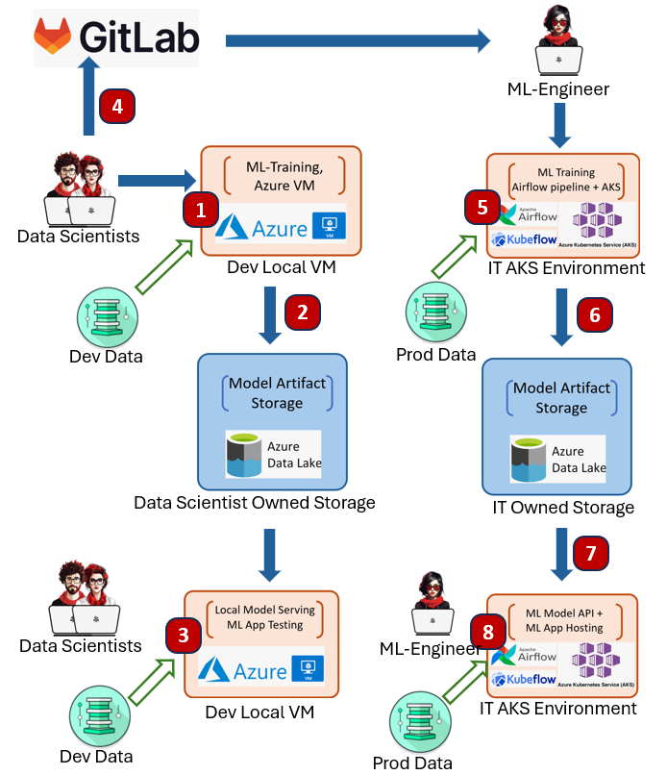
MDLC in Practice: Case 1: IT Centric Training and Inference on AKS
In this example, Observed from two separate ML teams within UBS, Data Scientists develops ML Training pipeline on its Local VM, then hands over to IT for the model to be trained on IT maintained AKS based infrastructure.
Data scientists develop ML training pipelines and experiment scoring/selection modules in private UBS VMs or Azure VMs accessing development datasets.
Data scientists either manually run the training pipeline using a variety of ML frameworks, with model artifacts generated and persisted into the data scientist-owned Azure storage, for example, ABFS.
Data scientists can optionally pull those artifacts from storage and host the ML inference API locally for endpoint testing and ML app testing.
Data scientists check in ML training pipelines and experiment scoring/selection modules to GitLab.
IT ML engineers check out the training and selection pipeline and schedule the model training in an IT-maintained AKS cluster having production data access. Often, an open-source pipeline framework is used, for example, Apache Airflow or Kubeflow pipeline.
The training and experiment scoring/selection pipeline will automatically select the best-performing model and store it in the IT-owned cloud storage.
ML engineers can deploy the ML API on AKS cluster real-time serving or cluster-based batch inferencing.
ML engineers can follow the SDLC process to deploy ML applications on IT AKS clusters consuming the ML API endpoints. For batch inferencing, often the workload is scheduled by Apache Airflow or Kubeflow. There are commercial solutions such as Seldon, but they have not been adopted within UBS.
Advantages:
Container based training and inference solution based on popular open-source framework Kubeflow / Airflow.
Better IT involvement in Model inference API and ML App deployment and hosting.
Low up front cost setup.
Disadvantages:
Data Scientists does not have a ML platform for easier model development environment setup, and Production data access.
Does not leverage experiment tracking server and model registry, Difficult to maintain model version and model security.
Difficult for IT to track ML Bill of Materials and ML model lifecycle status. Thus difficult for model governance
Training, Evaluation and Inference pipeline tends to be open-source vendor locked-in. For example, Kubeflow / Airflow pipeline, Higher IT maintenance cost.
No clear strategy for Continuous Integration, Continuous Training, Continuous Monitoring automation.
No MLSecOps process to check for ML Model vulnerability.

Slide 34
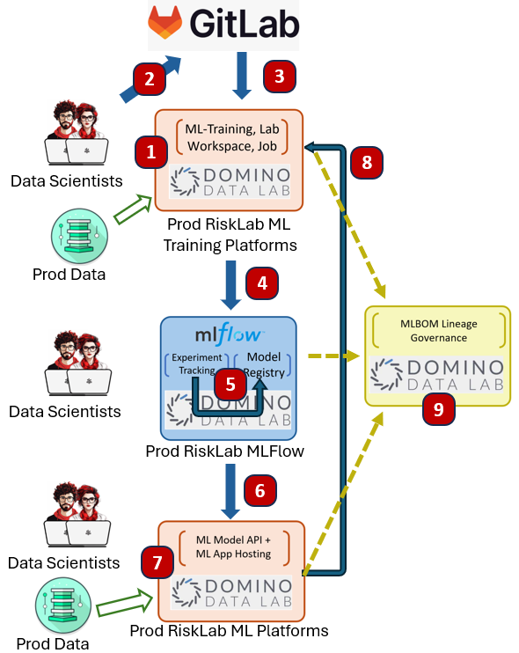
MDLC in Practice: Case 2: Data Scientist Centric Training and Inference on ML Platform
Another pattern within UBS is that divisional analytic Lab environment leverages end to end ML platform such as Domino Data Labs, CDWB, Dataiku and Databricks. ML Platform tends to provided federated eco-system for data scientist centric MLOPS. However, those ML Platform tends to encourage vendor environment / library lock-in, In below example on Domino Data Lab, RiskLab tends draw a balance to leverage open-architecture technology to avoid strong vendor lock in.
Data Scientists develops ML training pipeline (Kedro) in Production model development environment with direct production data access, RiskLab opt for open-architecture Kedro training pipeline vs Domino own training pipeline library to avoid vendor technology lock in.
Data Scientists checks in ML training pipeline to GitLab.
Data Scientists schedule Domino Jobs, which checks out training pipeline from GitLab and starts executing the training pipeline within Domino AKS.
Training pipeline generates one or more experiments and each experiments has model artifacts created and stored within MLFlow experiment tracking.
Data Scientists can optionally register an experiment run’s artifacts to MLFlow model registry for Lab model publishing
Data scientists publishes ML model as a Domino Model API for batch or real time inferencing.
Data scientists can also develop ML application (for example, Streamlit, Dash, ReactJS) and publish the ML App to Domino App. RiskLab can support EUA ML applications inference with production data.
Domino can setup your model to be continuous monitored and define scheduled check to alert on drift and programmatically retrain model.
Domino Data Lab tracks ML Bill of Materials information for end-to-end Model governance (Preview)
Advantages:
Better environment management for workspace, jobs and ML application inference. Quicker time to market.
Good GIT integration, able to directly checkout ML Training pipeline directly to workspace or jobs.
Access to production data in model development environment. Does not need retrain in IT maintained environment.
Fully integrated platform provided MLFlow experiment tracking server + MLFlow model registry.
Some platform, such as Domino Data Lab, provides end to end ML Bill of Materials tracking (Preview)
Great for hosting End User Application ML Apps (EUA) directly by Data scientist.
Good support to CICD, and CTCM, Domino Job can be scheduled to run period job training.
Disadvantages:
Vendor specific Federated MLFlow experiment tracking, Model registry, Model cannot be tracked and registered centrally.
MLBOM tracking is vendor specific. Thus restrictive.
Data Scientists owned process cannot fulfil SDLC for IT to deploy ML Model and ML App to IT environment.
No strong support for CICT from GitLab events (for example, runs pipeline upon merge)
No MLSecOps process to check for ML Model vulnerability.

Slide 35
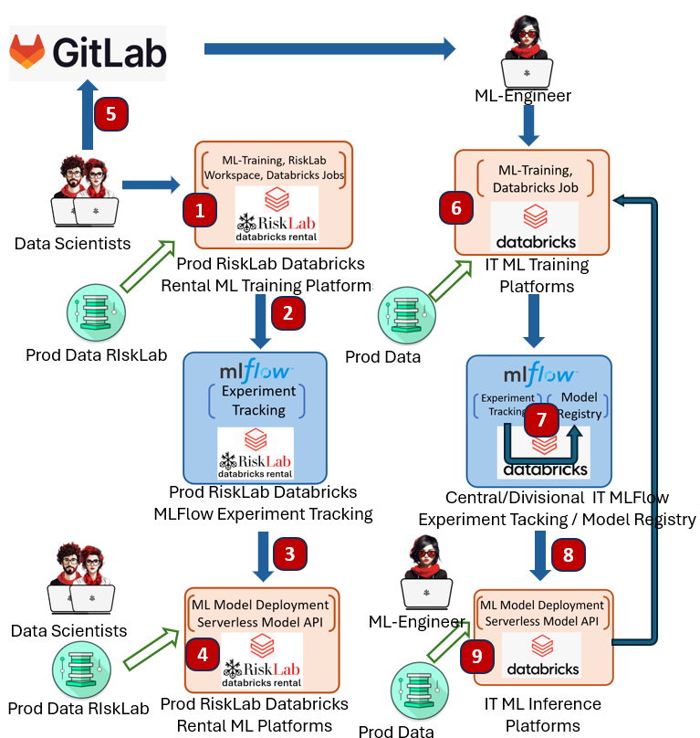
MDLC in Practice: Case 3: Best of both world, Data Scientist ML Platform transits into IT owned ML Platform
To address the issues and disadvantages in Case 1 and Case 2, RiskLab also support a hybrid approach to leverage the advantage of both approaches. The work is currently WIP and will be completed by Q2 2024. Key improvements:
Extends RiskLab Databricks Rental to Machine learning model development, allowing Data Scientist to develop ML training in containerized workspaces with GitLab integration.
Introduce the concept of centralized / divisional MLFlow model registry, allowing Model sharing with RBAC roles.
Allowing IT to train and publish production model by running training / model registry / Inference in IT owned ML platform.
Data Scientists develops ML training pipeline and experiment scoring / selection module in RiskLab Databricks rental workspace (MLFlow Pipeline / Kedro) in production tier model development environment with direct product data access.
Data Scientists either manually runs the pipeline or schedule databricks ML training jobs. Training pipeline generates one or more experiments and each experiments has model artifacts created and stored within Risklab Databricks Rental MLFlow experiment tracking sever
Data scientists can optionally manually publish ML model onto Databricks serverless Model serving API (UBS curated End of Q2, 2024)
Data Scientist can optionally develop and hosting ML Application in RiskLab Databricks Rental Lakehouse App (Private Preview, no UBS curation date) , or hosting in an external solution.
Data Scientists checks in ML training pipeline and experiment scoring / selection module to GitLab
IT ML Engineer checks out training and selection pipeline and schedule the model training in an IT environment having production data access.
The training and experiment scoring, and selection pipeline will auto select the best performing model and registry it with Central / Divisional MLFlow model registry.
ML Engineer can deploy the ML API for Serverless real time serving or Cluster based batch inferencing.
ML Engineer can follow SDLC process to deploy ML application within Lakehouse App or from an external IT maintained Application hosting.
Advantages:
Data Scientists can leverage Databricks ML platform whilst still developing the ML Model in their favourite workspace environment, As Databricks notebooks is insufficient for Library based model development.
Centralized MLFLow model registry with RBAC access control for models.
IT able to execution GitLab training pipeline and have full control of model generation lineage, and able to productionized model independently from data scientists.
Disadvantages:
Databricks yet to offer end-to-end MLBOM tracking solution.
Continuous integration and Continuous Training are Databricks platform centric. And could not be triggered from GitLab.
Databricks MLFLow model lifecycle tracking is inadequate to track Corporate complex lifecycle status.
Databricks does not offer MLSecOps process to check for ML Model vulnerability.

Slide 36
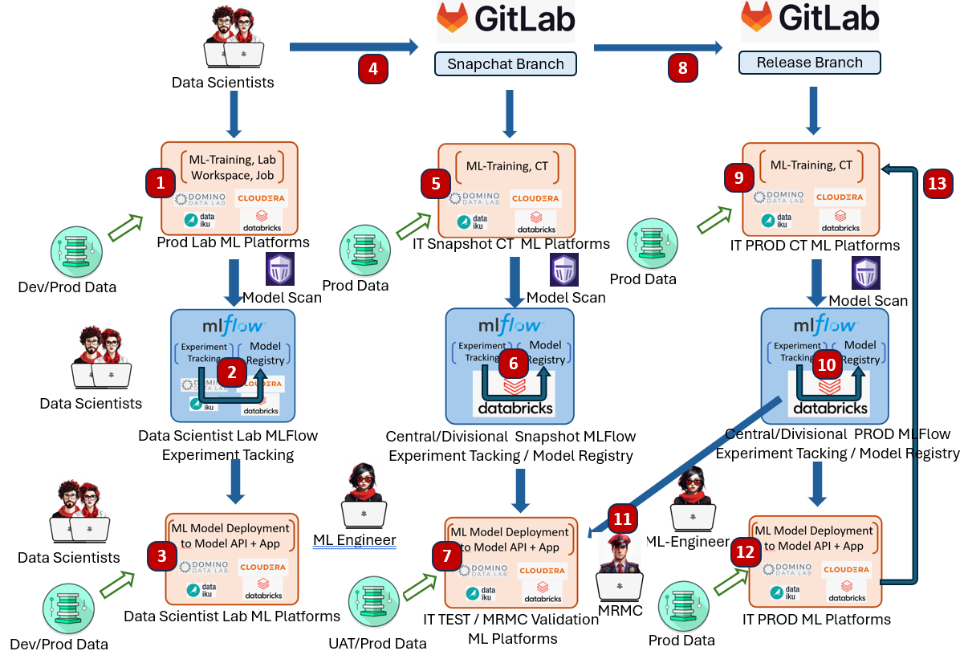
Future “End-Game” MDLC Architecture.
Data Scientists uses their preferred ML model development platform (Domino Data Lab, Databricks, CDWB, AML, Dataiku) to develop their ML training pipeline and model selection module. The platform may or may not have production data access. The generated experiment model artifacts can be security scanned by PROTECT AI Guard to ensure the model artifacts generated is secure.
Data Scientists can optionally register an experiment run’s artifacts to MLFlow model registry for Lab model publishing
Data scientists may want to publishes ML model as Model and hosting ML app for development inferencing.
Data scientists merge the training and evaluation pipeline into a snapshot branch in Gitlab, and Gitlab triggers the Continuous Training pipeline.
Since GitLab does not perform ML training environment yet, the continuous training has to be delegated to IT maintained ML training ML platform by calling APIs in Domino Data Lab, Databricks, CDWB, AML, Dataiku)
GIT pipeline triggers model evaluation and registers best performing Model(s) to snapshot model registry
ML Engineer can deploy to IT maintained ML testing platform to perform model testing.
Once model is tested, Data scientists can merge snapshot branch to release branch, trigger GitLab CT pipeline
As in Step 5, training is delegated to separate ML 7. platforms,
As in step 6, Best performing model is auto selected and published to production model registry.
Production ready model can be either deployed to IT Test ML platform or MRM Validation ML Platform for model testing and validation.
ML engineer could deploy the model into production for real time or batch inferencing.
ML Platform such as Databtricks and AML could trigger additional Continuous Monitoring.
To address the inefficiency in Case 3. A future ML landscape could be defined as below.
Federated ML Platforms and centrally MDLC coordinated through GitLab CI pipeline. GitLab CI triggers ML Platform Continuous Training workload (CT)
Centralized Snapshot / Release MLFLow Model Registry, with integration of PROTECT AI Gurdian Model Security scan.
Production Model trained on GitLab triggered Production ML Platform, tested and validated by IT and MRMC .
Below design does not offer any options to track ML Bill of Materials, it will be discussed in depth in the next 2 slides.

Slide 37
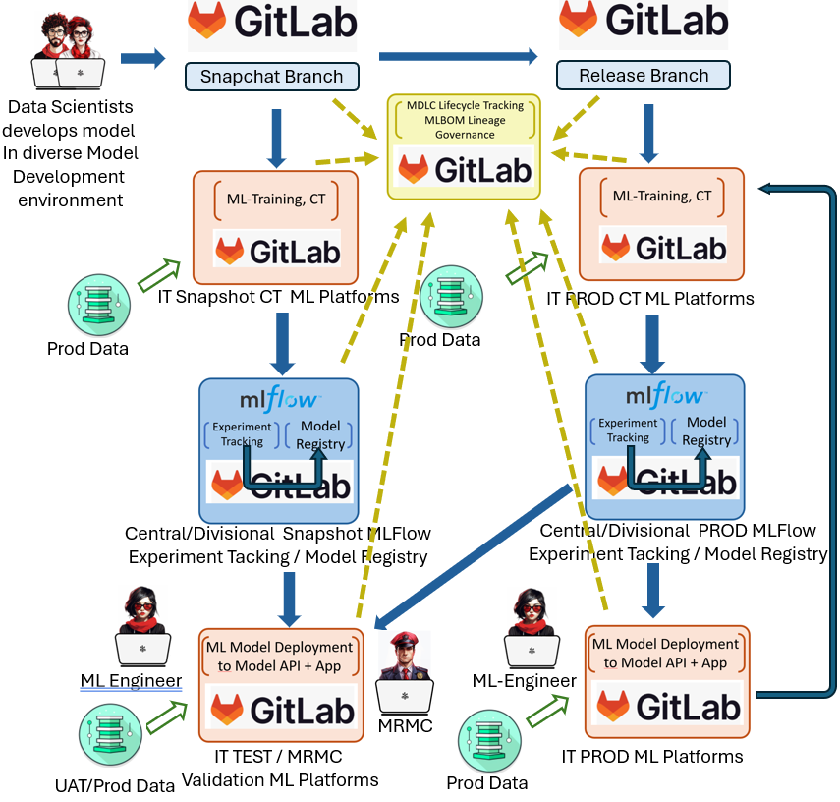
Future “End-Game” MDLC Architecture Variant 1 to support MLBOM: GitLab centric
As of 2024, ML Bill of Materials are mainly supported in federated ML Platforms. Since GitLab is the bank’s SDLC implementation platforms, and GitLab is working toward a complete end to end ML Solution. We would ideally want GitLab to provide the following functionalities in order to capture the complete MLBOM
GitLab pipeline and AKS cluster could support Continuous Trainings to machine learning models. i.e. not limiting GitLab for artifact building job, but for ML model training jobs.
GitLab Model registry could allow Central / Divisional model registry management and access control.
GitLab Model registry provide ML lifecycle status that can be customized according to client definition.
GitLab AKS cluster could provide ML Model API hosting for real time and batch inferencing.
GitLab AKS cluster could provide ML App hosting.
A GitLab central panel could see the complete MLBOM information.
However, GitLab only started MLOps development since 2022, and their product has not matured yet, We see the described landscape might be potentially fulfilled in 2026/2027. The challenges are:
GitLab Model registry are only limited to Project scope. Does not provide central model registry management and access control.
GitLab needs to provide product roadmap in support ML pipeline including advanced multi-cluster ML trainings
GitLab needs to provide product roadmap in ML model API hosting similar to HuggingFace space, and the SLA needs to be production grade.
As above, the same would also apply to ML Application hosting.
We would put this design as a target vision that we egerly awaits GitLab to deliver.

Slide 38

Future “End-Game” MDLC Architecture Variant 2 to support MLBOM: Federated ML Platforms with centralized MLBOM and Lifecycle tracking.
Whilst await GitLab to deliver the complete end-to-end MLOps and MLBOM solution. UBS could still leverage diverse choice of ML Platforms for ML CT, CD and CM.
Protect AI is the industry leading MLSecOps company, and its RADAR product offers complete observability of “tamper-proof” ML Bill of Materials (MLBOM) for comprehensive list of components and dependencies of your ML model. It recognizes that corporation often leverages diverse range of ML Platform, rather for impose close coupling to individual ML Platform, The MLBOM information is extracted by deploying RADAR agent through the lifecycle of ML model at different ML platform for CT and CM, and GitLab for CI and CD.
A UBS in-house built MDLC lifecycle Tracking application can be built on top of the PROTECT AI gathered MLBOMs. As ML lifecycle stages is a key MLBOM for Protect RADAR to track.
GCTO Big Data team, RiskLab and GCRG Model methodology has done a PoC on UBS MDLC lifecycle application during the 2023 Hackathon to support the ML model lifecycle tracking from diverse range of ML Training and Inference platform. This PoC could be leverage PROTECT AI RADAT framework to also offer additional observability of ML Model Bill of Materials information.
Advantage of the Variant 2:
Quick Time to Market for end of end ML CICDCTCM solution.
Allowing Diverse range of ML Platform to be supported.
UBS custom in house lifecycle application with MLBOM tracking.

Slide 39


Copy over best
Performing models
(includes experiment runs)
Protect AI scan
UBS Model Export CLI
Central release Model Registry
ML Lab Platforms
Having only dev data access
IT maintained ML Lab Platforms
Having prod data access
Evaluate Model, Metrics, Data
Experiments on dev data
For purpose of generating
Training pipeline
Run expertiment
Against prod data
Check-in
training pipeline
+ ML App
Evaluate Code
Data Scientists
MRMC

Slide 40


Copy over best
Performing models
(includes experiment runs)
Protect AI scan
UBS Model Export CLI
Central Release Model Registry
ML Lab Platforms
Having production data access
Evaluate Model, Metrics, Data
Experiments on prod data
Log data referenes to MLFlow
experiments
Check-in
training pipeline
+ ML App
Evaluate Code
Data Scientists
MRMC

Slide 41
Auto register
All snapshot
Models, + scan
4
Central Snapshot
Model Registry
Central Release
Model Registry
Auto register
All release
Models, + scan
7
ML Lab Platforms
Having production data access
Evaluate Model, Metrics, Data
6
3
Rerun CICD which calls
Lab API for experiments
with smaller working
Parameters,
Experiments on prod data
Log data referenes to MLFlow
experiments
1
8
2
Check-in
training pipeline
To branch
Evaluate Code
5
Check into
release branch
Data Scientists

Slide 42

Central Snapshot
Model Registry
Central Release
Model Registry
ML Lab Platforms
Having production data access
Evaluate Model, Metrics, Data
Rerun experiment on GitLab AKS compute, Auto register All snapshot Models, + scan
Experiments on prod data
Log data referenes to MLFlow
experiments
Check-in
training pipeline
To branch
Evaluate Code
Check into
release branch
Data Scientists

Slide 43
UBS Deploy
Model Development Lab Enviorment:
Model
Registry
Model metadata
Model Artifects
:
model
main
review
release

Slide 44






8
7
10
9
1
3
5
6
11
13
2
4
12
Notes:
44

Slide 45



Model Development Lab Enviorment:
3
6
Model Review Lab Enviorment:
RiskLab, Domino, Dataiku,
Databricks, Azure ML Service
2
4
7
1
5
Notes:
45

Slide 46








Model Development Lab Enviorment:
3
6
IT Staging Enviorment
4
8
2
IT Dev Enviorment
GitLab CI
7
ML App
Artifect
Repo
5
1
Notes:
46

Slide 47




IT Production Enviorment
ML App Artifect
Repo
1
1
3
4
6
7
2
5
Notes:
47

